Slide 1
COM1302-Database Management Systems
ER-Relational Mapping

Slide 2
ER to Relational Mapping…
In the Database Design process, we firstly derive a conceptual model (ER Diagram)
This model needs to be mapped to the relational model in order to be implemented using a relational DBMS (RDBMS)
This section discusses the rules that can be used for this process…

Slide 3
Model Mapping
Moving from Conceptual (ER) to lower level Logical Model (Relational)
ER is independent of the details of the implementation (relational, network or OO)_
Logical model begins to introduce issues specific to implementations (as realtional tables)
Any such conversion is called a “schema mapping”

Slide 4
Core Concepts (Review)
Entity | Any object about which data is stored
Relation | 2-d table to implement storage of data abut entities
Attribute | A property of an entity; stored as a column in a table
Entity Instance | A row (tuple) in a table (relation)
A Key | The use of an attribute to identify specific instances within a table

Slide 5
Core Concepts (Review)
Candidate Key | Any attribute that uniquely identifies each row in a table
Primary Key | An attribute selected from the candidate keys to be used to uniquely identify each row
Composite Key | A primary key tat is made up of two or more attributes
Foreign Key | An attribute that is not itself a key but is a PK in another table; to join tables in relational databases

Slide 6
ER to Relational Mapping… (contd.)
ER Model Relational Model
Entity (strong) → Relation
For example,
ARTIST
ARTIST

Slide 7
ER to Relational Mapping… (contd.)
ER Model Relational Model
Simple Attributes → Attributes
For example,
ARTIST
name
ARTIST
name

Slide 8
ER to Relational Mapping… (contd.)
ER Model Relational Model
Primary Key → Primary Key
For example,
ARTIST
ARTIST
name
name

Slide 9
ER to Relational Mapping… (contd.)
ER Model Relational Model
Composite attributes → Set of simple atomic attributes
For example,
EMPLOYEE
surname
EMPLOYEE
surname
firstname
firstname
fullname

Slide 10
Rules to Convert (ER – Tables)
For 1:1 Cardinality, all attributes should be merged into single table
1:N ; post identifier (PK) from one side as an attribute into the many side
N:M ; create a new table and post identifiers from each of the linked entities as attributes in the table

Slide 11
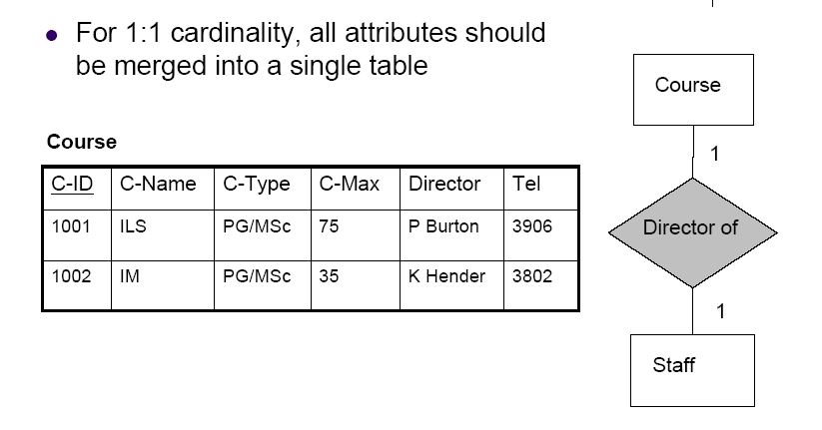
Conversion

Slide 12
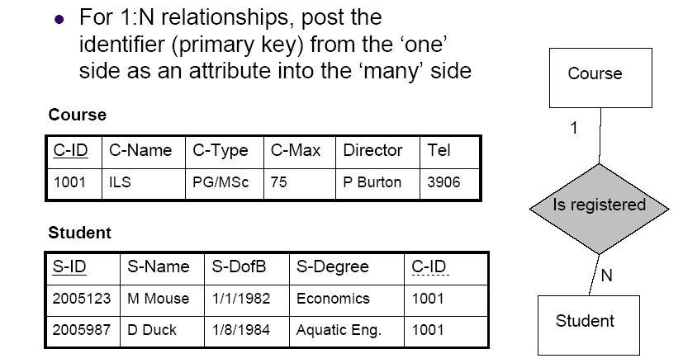
Conversion
FK

Slide 13
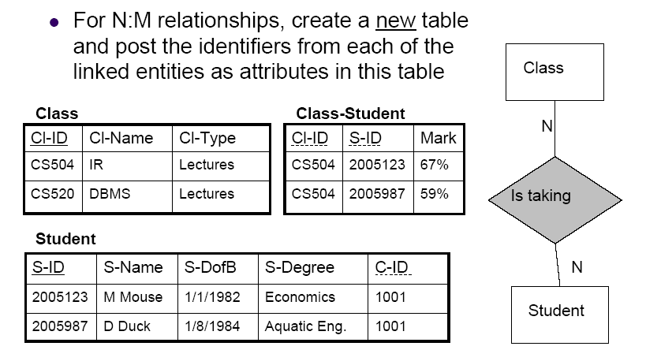
Conversion
FK
FK

Slide 14
ER to Relational Mapping… (contd.)
ER Model Relational Model
Multivalued attribute → Relation & Foreign Key
For example,
ART-OBJECT
id
ART-OBJECT
MATERIALS
id
material
id
materials

Slide 15
ER to Relational Mapping… (contd.)
ER Model Relational Model
N-ary relationship “Relationship” relation and n foreign keys
For example,
A
B
pk_{B}
pk_{A}
A
B
R
pk_{A}
pk_{B}
pk_{C}
pk_{D}
r
C
D
C
D
pk_{C}
pk_{D}

Slide 16
ER to Relational Mapping… (contd.)
ER Model Relational Model
Weak Entity Relations and combination of partial and primary keys
1
N
Policy
DEPENDENTS
EMPLOYEE
id
name
age

Slide 17
ER to Relational Mapping… (contd.)
EMPLOYEE
id
DEPENDENTS
id
name
age

Slide 18
Mapping - Summary
ER Model Relational Model
Entity (strong) -> Relation
Simple Attributes -> Attributes
Primary Key -> Primary Key
Composite attributes -> Set of simple attributes
1:1 or 1:N relationship -> Foreign keys
M:N relationship -> Relation and foreign keys
Multivalued attribute -> Relation and foreign key
N-ary relationship -> Relation and n foreign keys
Weak Entity -> Relation and combination of -> primary and partial keys

Slide 19
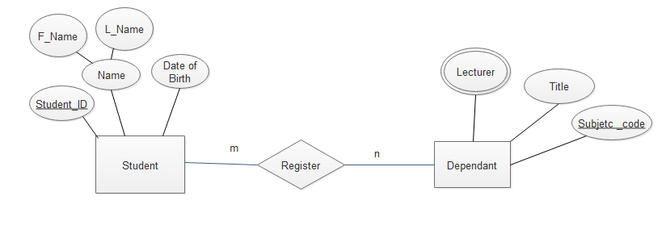
Convert the following ERD fragment into corresponding relations

Slide 20
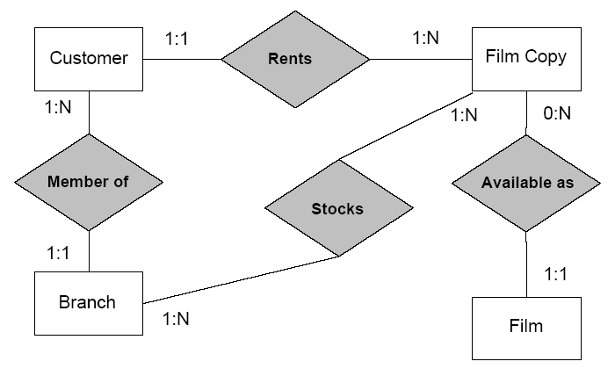
Your Turn

Slide 21
Use the rules introduced to build a set of tables
Have two 1:N relations between Branch & Film
Examine the link between Customer and Film copy

Slide 22
Questions?

